Slide 1
Employee Salary Prediction Using Linear Regression
Santhosh Vijayagiri
Data Science Project

Slide 2
Project Overview
Goal: Predict employee salaries using machine learning.
Algorithm: Linear Regression
Features: Years of Experience, Education Level
Tools: Python, Pandas, NumPy, Matplotlib, Scikit-learn

Slide 3
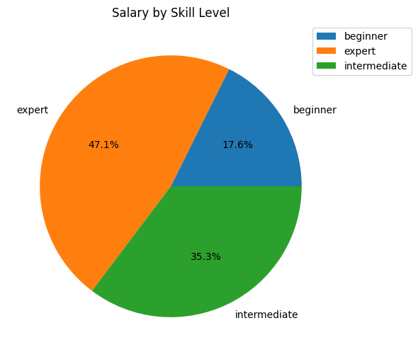
Salary by Skill Level
This pie chart explains about salary changes according to skill level
An employee with expert qualification earns 12% more salary than an intermediate..
This shows experience matter and skill level matters more salary decision making.

Slide 4
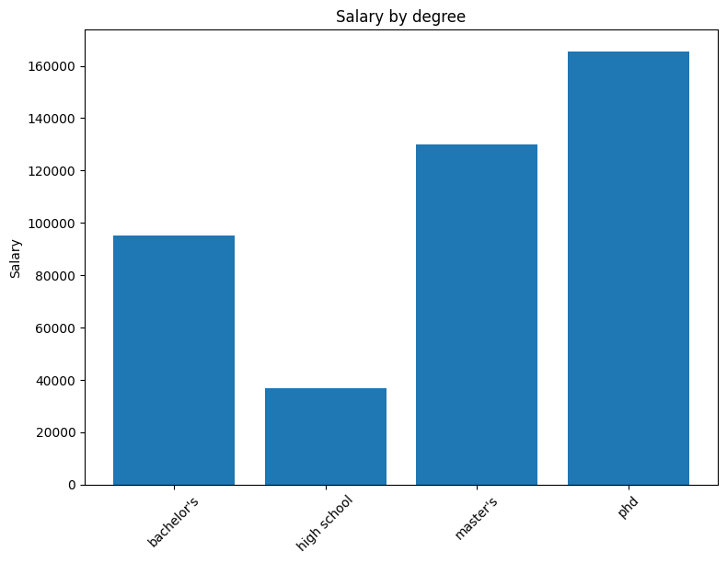
Salary by Degree
This bar plot shows comparison between different degrees .
An employee with Phd has avg salary of 1,60,000 in a company.
With this plot we can say degree play a major role in salary variation

Slide 5
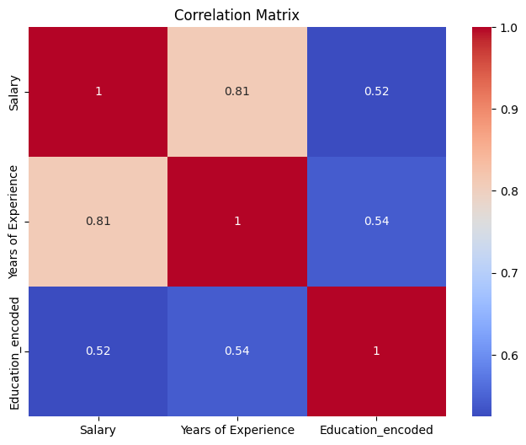
Salary by Degree
It show the relation between variables in heat map
Years of experience and education_encoded have 50% more relation with price
This graph helps us to choose columns for regression model

Slide 6
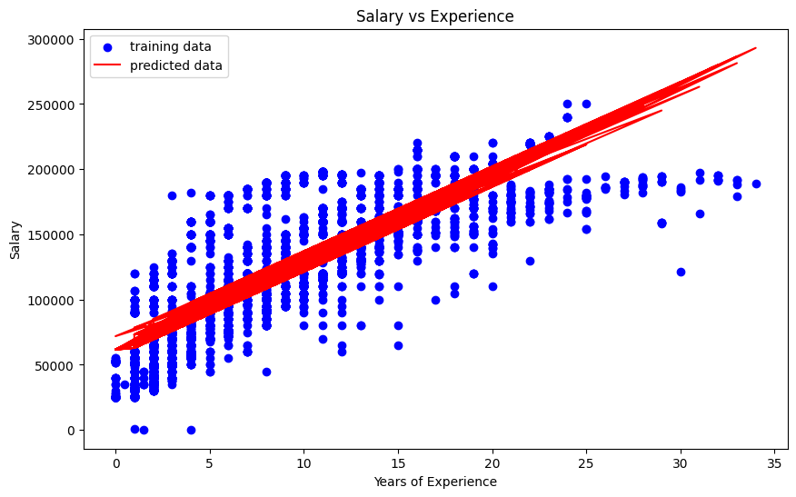
Salary vs Experience(regression plot)
There are total three variables in regression expression .
So a 2d graph can’t explain this data

Slide 7
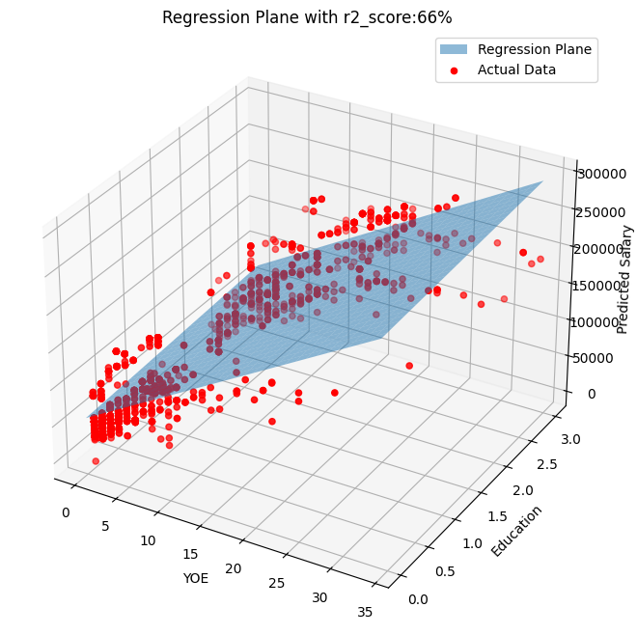
Regression Plane (R² = 66%)
No of variables:
X1:years of experience(YOE)
X2:Education
Y:predicated salary
So a 3d plot much useful to explain the regression plot

Slide 8
Model Results
The Linear Regression model shows a positive relationship between experience and salary.
Model Performance:
R² Score = 0.66 (66%)
This means the model explains 66% of salary variation.

Slide 9
Conclusion
Salary increases with experience and education level.
Machine learning helps organizations make data-driven salary decisions.
Future work: add more features like job role, location, and skills.

